Slide 1
Revelation 1:1-20

Slide 2
1 The revelation of Jesus Christ, which God gave him to show to his servants the things that must soon take place. He made it known by sending his angel to his servant John, ² who bore witness to the word of God and to the testimony of Jesus Christ, even to all that he saw. ³ Blessed is the one who reads aloud the words of this prophecy, and blessed are those who hear, and who keep what is written in it, for the time is near.
⁴ John to the seven churches that are in Asia:
Grace to you and peace from him who is and who was and who is to come, and from the seven spirits who are before his throne, ⁵ and from Jesus Christ the faithful witness, the firstborn of the dead, and the ruler of kings on earth.

Slide 3
To him who loves us and has freed us from our sins by his blood ⁶ and made us a kingdom, priests to his God and Father, to him be glory and dominion forever and ever. Amen. ⁷ Behold, he is coming with the clouds, and every eye will see him, even those who pierced him, and all tribes of the earth will wail on account of him. Even so. Amen.
⁸ “I am the Alpha and the Omega,” says the Lord God, “who is and who was and who is to come, the Almighty.”

Slide 4
⁹ I, John, your brother and partner in the tribulation and the kingdom and the patient endurance that are in Jesus, was on the island called Patmos on account of the word of God and the testimony of Jesus. ¹⁰ I was in the Spirit on the Lord’s day, and I heard behind me a loud voice like a trumpet ¹¹ saying, “Write what you see in a book and send it to the seven churches, to Ephesus and to Smyrna and to Pergamum and to Thyatira and to Sardis and to Philadelphia and to Laodicea.”
¹² Then I turned to see the voice that was speaking to me, and on turning I saw seven golden lampstands, ¹³ and in the midst of the lampstands one like a son of man, clothed with a long robe and with a golden sash around his chest.

Slide 5
¹⁴ The hairs of his head were white, like white wool, like snow. His eyes were like a flame of fire, ¹⁵ his feet were like burnished bronze, refined in a furnace, and his voice was like the roar of many waters. ¹⁶ In his right hand he held seven stars, from his mouth came a sharp two-edged sword, and his face was like the sun shining in full strength.
¹⁷ When I saw him, I fell at his feet as though dead. But he laid his right hand on me, saying, “Fear not, I am the first and the last, ¹⁸ and the living one. I died, and behold I am alive forevermore, and I have the keys of Death and Hades.

Slide 6
¹⁹ Write therefore the things that you have seen, those that are and those that are to take place after this. ²⁰ As for the mystery of the seven stars that you saw in my right hand, and the seven golden lampstands, the seven stars are the angels of the seven churches, and the seven lampstands are the seven churches.

Slide 7
The Revelation of Jesus Christ
Why Satan doesn’t want us to read it:
It reminds us that we’re on the winning side
Jesus Christ is victorious; Satan is doomed; Nothing to fear
God is on His throne. His hand controls the past/present/future
Why we should read it:
We benefit by studying this book
It encourages a church in (or approaching) persecution
We are promised a blessing by reading / hearing it / keeping it

Slide 8
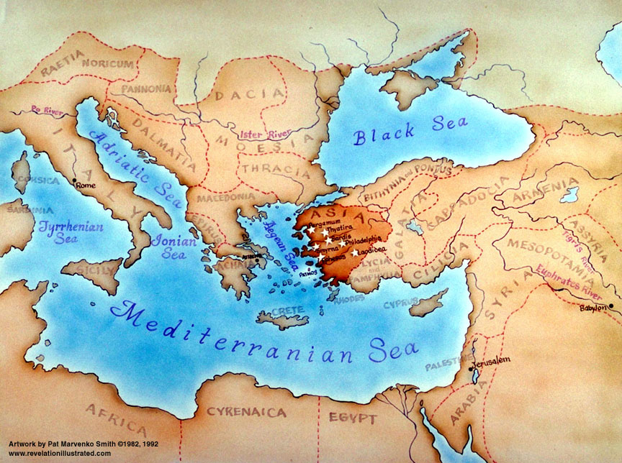
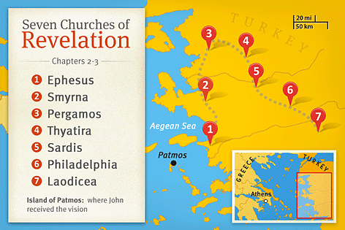

Slide 9
¹⁸ I warn everyone who hears the words of the prophecy of this book : if anyone adds to them, God will add to him the plagues described in this book, ¹⁹ and if anyone takes away from the words of the book of this prophecy, God will take away his share in the tree of life and in the holy city, which are described in this book.

Slide 10
The Revelation of Jesus Christ
Why Satan doesn’t want us to read it:
It reminds us that we’re on the winning side
Jesus Christ is victorious; Satan is doomed; Nothing to fear
God is on His throne. His hand controls the past/present/future
Why we should read it:
We benefit by studying this book
It encourages a church in (or approaching) persecution
We are promised a blessing by reading / hearing it / Keeping it
Cursed are those who add to or take away from this book
At times I will say, “I don’t know what this means.”
Be very wary of those who claim to have all the answers
A big word:
Eschaton = “the end times”
Eschatology = “the study of end times”
Eschatological = “relating to end times”

Slide 11
The Revelation of Jesus Christ
Satan doesn’t want us to read it: Satan doomed Christ Victorious
God is on His throne. His hand controls the past/present/future
It encourages a church in (or approaching) persecution
We are promised a blessing by reading / hearing it
Cursed are those who add to or take away from this prophecy
We don’t yet know what all of it means
Be wary of those who claim to have all the answers
4 ways people interpret Revelation
Eschatological “relating to end times”
1. Preterist
about and for John’s Generation
Uses veiled language to describe events
2. Futurist
about the future. Events are yet to happen
3. Historicist
A chart of history from when Jesus ascended until when He returns
4. Idealist
Doesn’t refer to historical events at all
Principals that are always valid in Christian experience

Slide 12
The Revelation of Jesus Christ
Satan doesn’t want us to read it: Satan doomed Christ Victorious
God is on His throne. His hand controls the past/present/future
It encourages a church in (or approaching) persecution
We are promised a blessing by reading / hearing it
Cursed are those who add to or take away from this prophecy
We don’t yet know what all of it means
Be wary of those who claim to have all the answers
Ἀποκάλυψις (apokalypsis) – something that once was hidden, but now it has been revealed (revelation)
Apocalyptic literature
Uses images to reveal a message
The image is not a picture of exactly what we will see

Slide 13
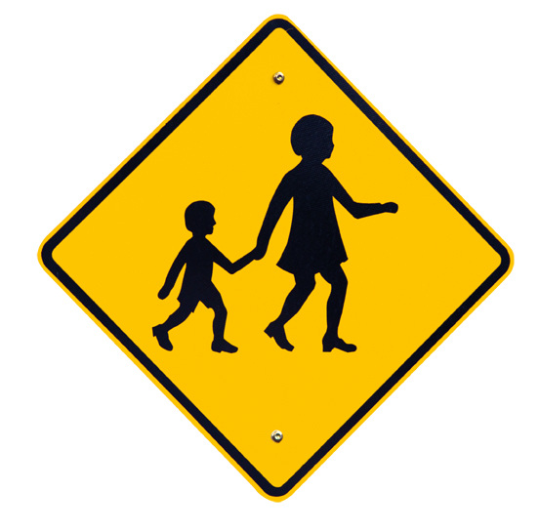

Slide 14
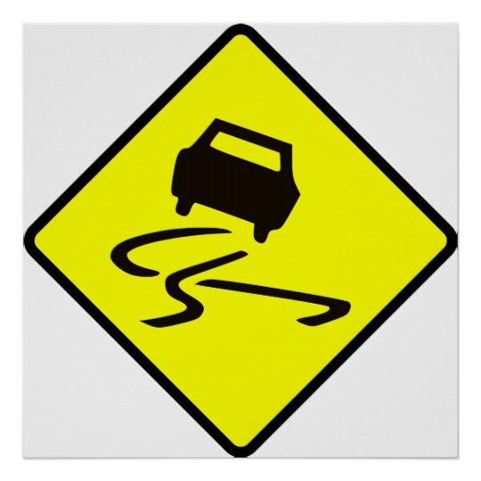

Slide 15


Slide 16
The Revelation of Jesus Christ
Satan doesn’t want us to read it: Satan doomed Christ Victorious
God is on His throne. His hand controls the past/present/future
It encourages a church in (or approaching) persecution
We are promised a blessing by reading / hearing it
Cursed are those who add to or take away from this prophecy
We don’t yet know what all of it means
Be wary of those who claim to have all the answers
Ἀποκάλυψις (apokalypsis) – something that once was hidden, but now it has been revealed (revelation)
Apocalyptic literature
Uses images to reveal a message
Not a picture of exactly what we will see
Some of the signs will be obvious
Some will be explained within the Revelation
Some will be explained from other parts of the Bible
Some are not yet explained

